Slide 1

Job Portal A platform to search your Dream job
Group Members:
Ghale Kiran 1724055
Ghimire Subin 1724052
Dahit Santosh 1724044

Slide 2
Contents
Introduction
Purpose
Tools & technology
Features
Benefits
Main Websites

Slide 3
Introductions
Job portal is developed for creating an interactive job vacancy Portal for candidates.
Flat form to update for both companies & job seeker.

Slide 4
Cont…
Enable jobseekers to place their resumes and find jobs while companies to publish their vacancies and find good candidates.
Enables jobseekers to post their resume, search for jobs, view personal job listings.

Slide 5
Purpose
Platform for finding a right and a satisfactory job.
Connects the job seekers with the major organizations.
Provides latest news for job vacancy
Searching for qualified applicant
Easy to choose the company

Slide 6
Tools & technology
Php
Mysql
Html
CSS
Notepad++
Brackets
Google chrome
Bootstrap
000webhostapp.com(For hosting)

Slide 7
Features
Online Job Features:
Administrative
Job Search
Administrative features

Slide 8
Cont..
Company features.
Search for jobs
Apply Online for desire job
Add/Edit profile information.
Upload latest resume.

Slide 9
Cont…
Main Websites:
Register as a jobseeker or as a job provider
Login to jobseeker or job provider portal
About Us
Contact us
Recent Jobs

Slide 10
Benefits
Job seekers does not have to travel.
Cost efficient for both Companies and Job seekers.
Time efficient for both Companies and Job seekers.
24 x 7 Availability.

Slide 11
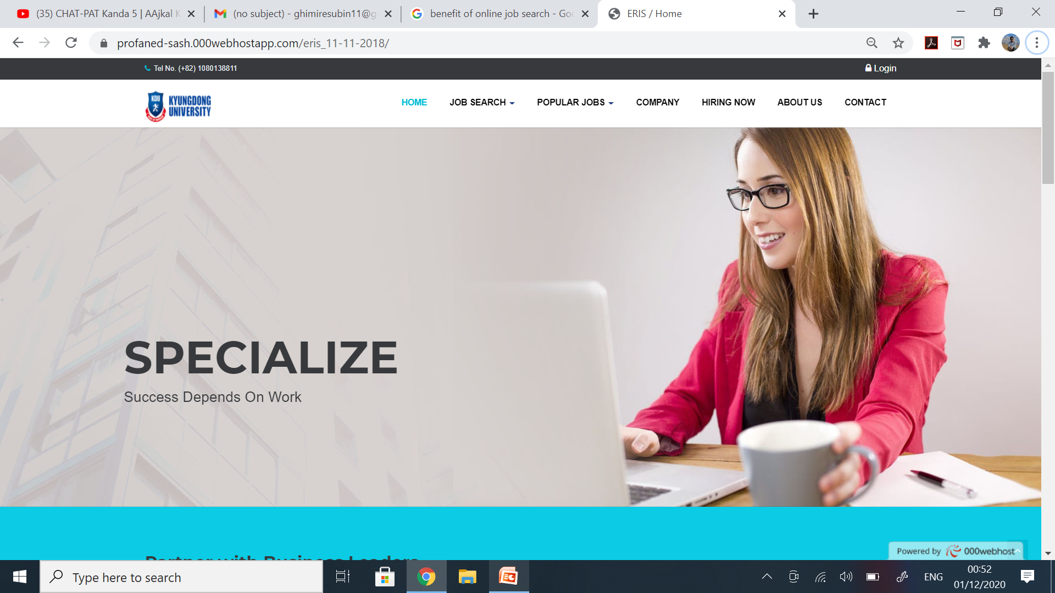
Homepage

Slide 12
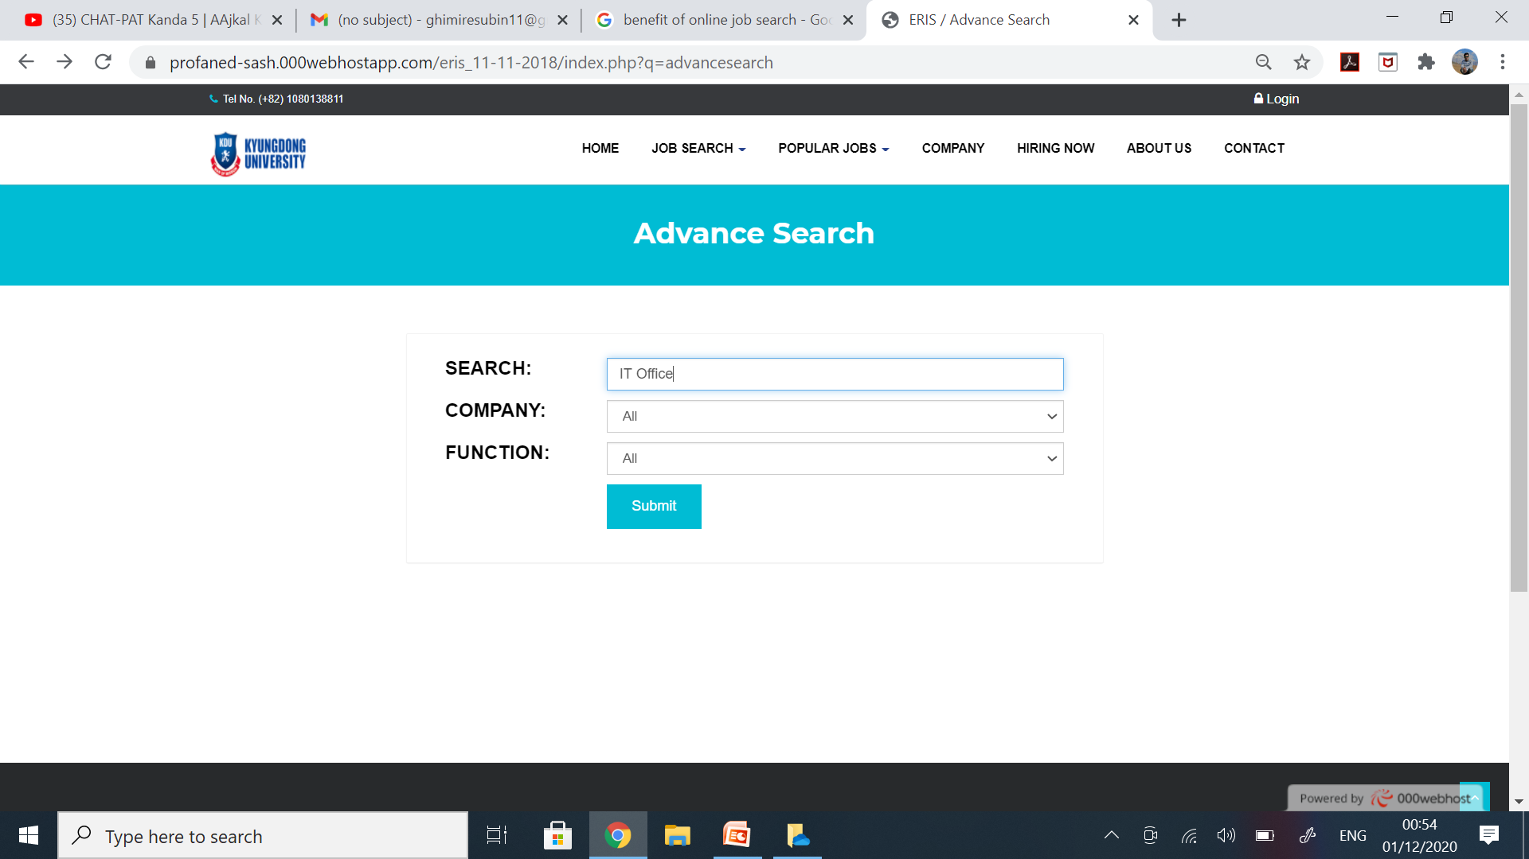
Job Search

Slide 13
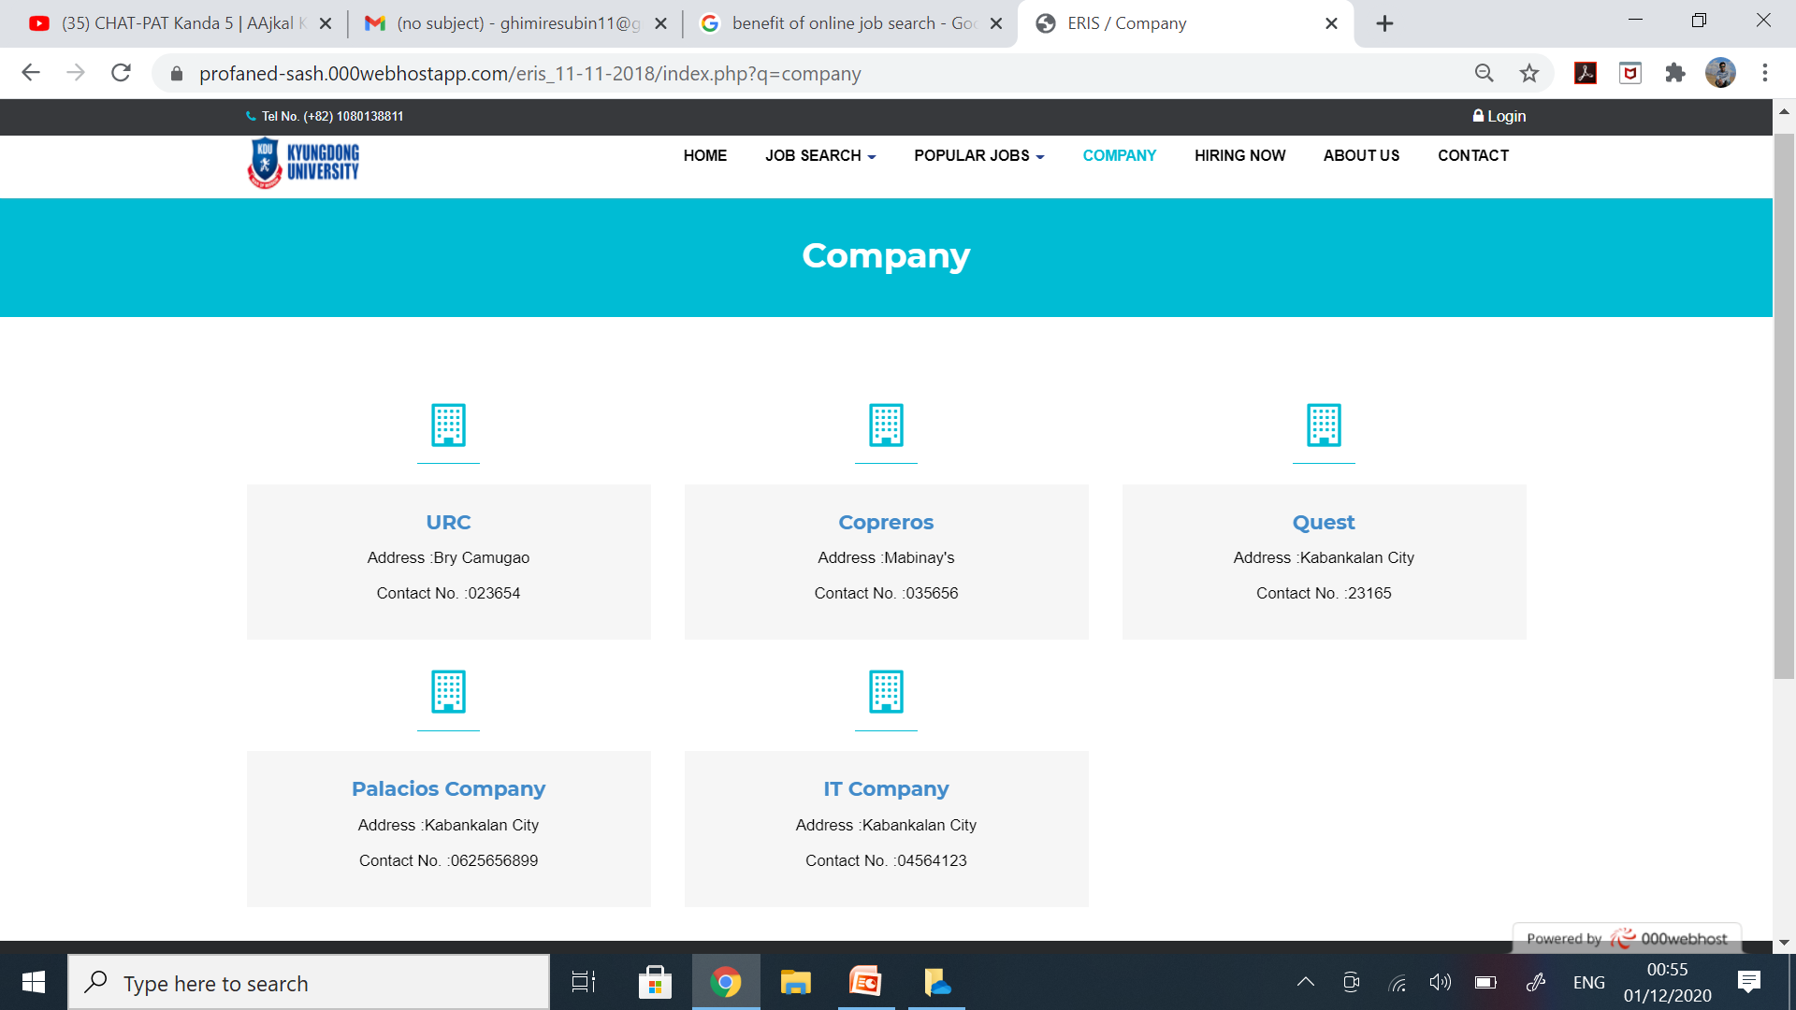
Company

Slide 14
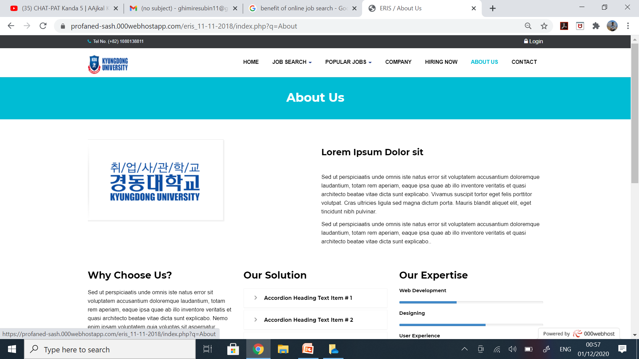
About US

Slide 15
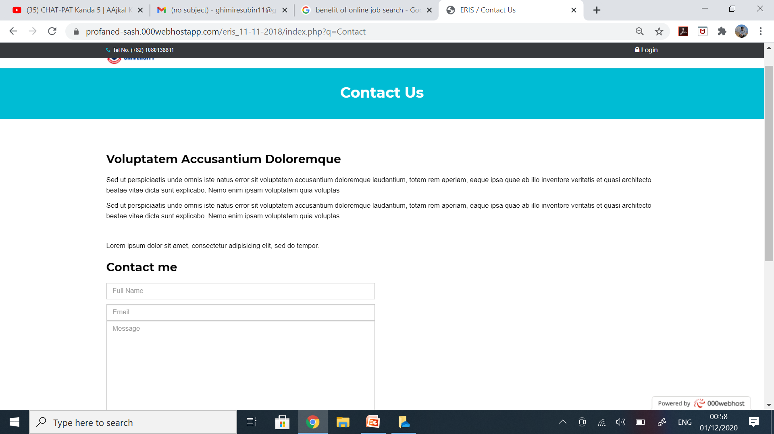
Contact Us

Slide 16
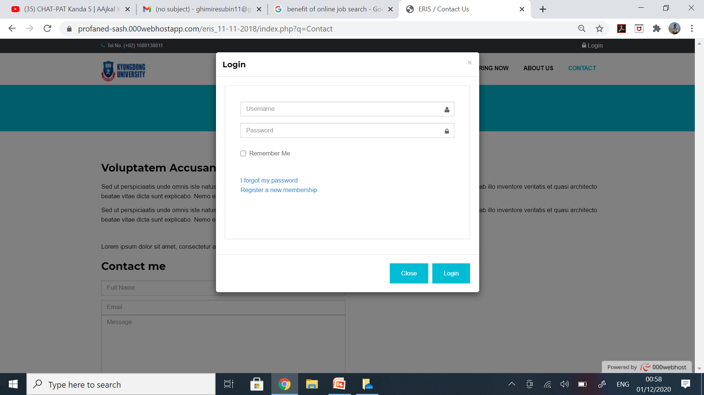

Slide 17
Hosting Link
https://profaned-sash.000webhostapp.com/eris_11-11-2018/index.php

Slide 18
Conclusion
Form this job portal we can able to search job as well companies can find best candidate with less time with convenient way. While in this pandemic time , we try not to spread corona virus by using job portal.

Slide 19

Thank you!!!

